Slide 1

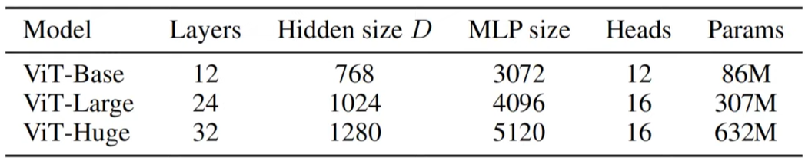
MULTIORGAN SEGMENTATION
problem statement: Multi-organ segmentation transformer for CT medical images
Real-life usage: segmenting multiple organs or structures within an image is a crucial step in medical image analysis and plays a significant role in tasks such as diagnosis, surgical planning etc.
Model: UNETR (vit encoder + cnn decoder)
DATASET: Synapse multi-organ segmentation dataset
(https://drive.google.com/drive/folders/1SLBdnhiReIbyYWbSqgIaPMM_GRZzuzAF?usp=sharing)
Model Architecture

Slide 2
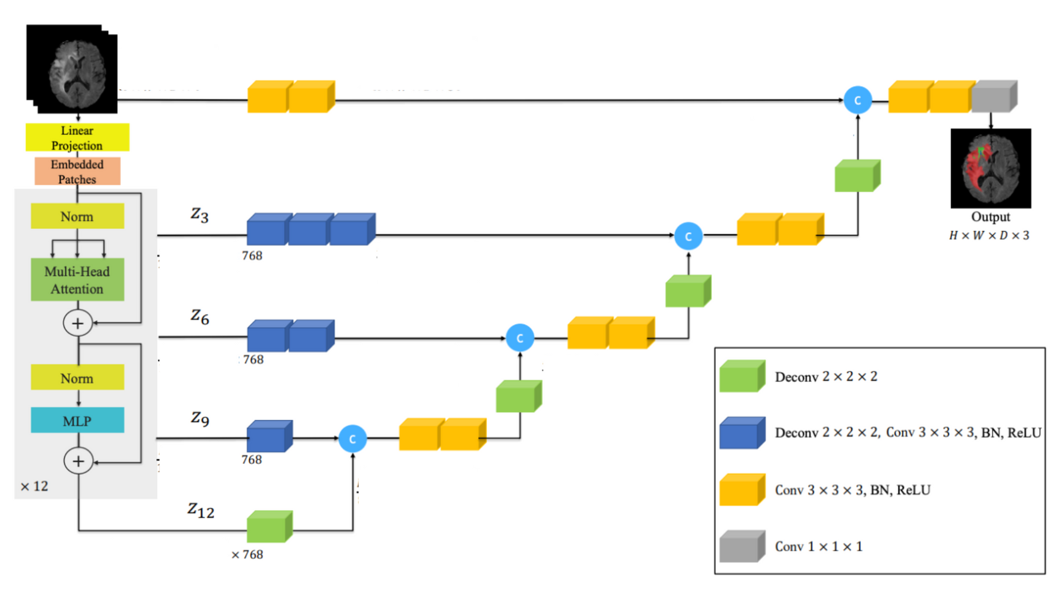
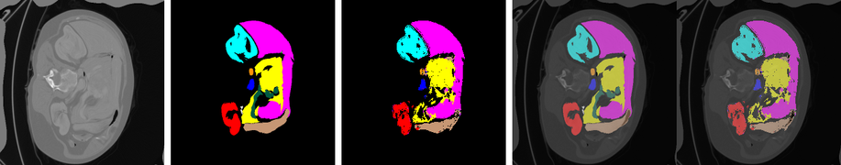
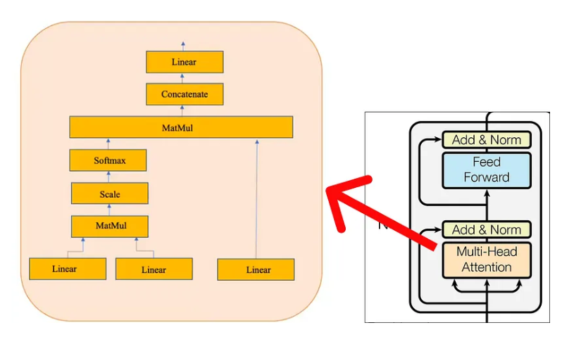
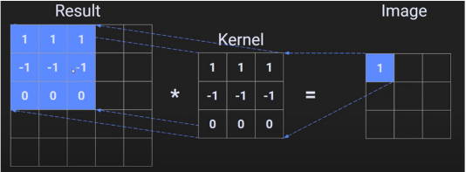
UNETR
256 x 256 x 128
256 x 256 x 128
256 x 256 x 128
256 x 256 x 11
256x256x3
256x256x3
11
256 x 256 x 64
flattening 256x768
256 x 256 x 64
12
256x768
10
256x768
128 x 128 x 256
256x768
8
9
256x768
256x768
128 x 128 x 128
128 x 128 x 128
256x64
16x16x
7
128 x 128 x 128
256 x 256 x 11
256x256
5
64 x 64 x 512
6
256x256
256x768
64 x 64 x 256
64 x 64 x 256
256x256
16x16x
4
64 x 64 x 256
256x768
256x64
256x64
256x64
32 x 32 x 512
3
32 x 32 x 1024
256x768
16x16x
2
32 x 32 x 512
32 x 32 x 512
16x16
1

Slide 3
STEPS:
1. flattening of image
2. Linear projection on flattened images
3. position embeddings
4. normalization
5. multihead attention
6. normalization
7. Multilayer perception
8. Deconv block
9. Conv block

Slide 4
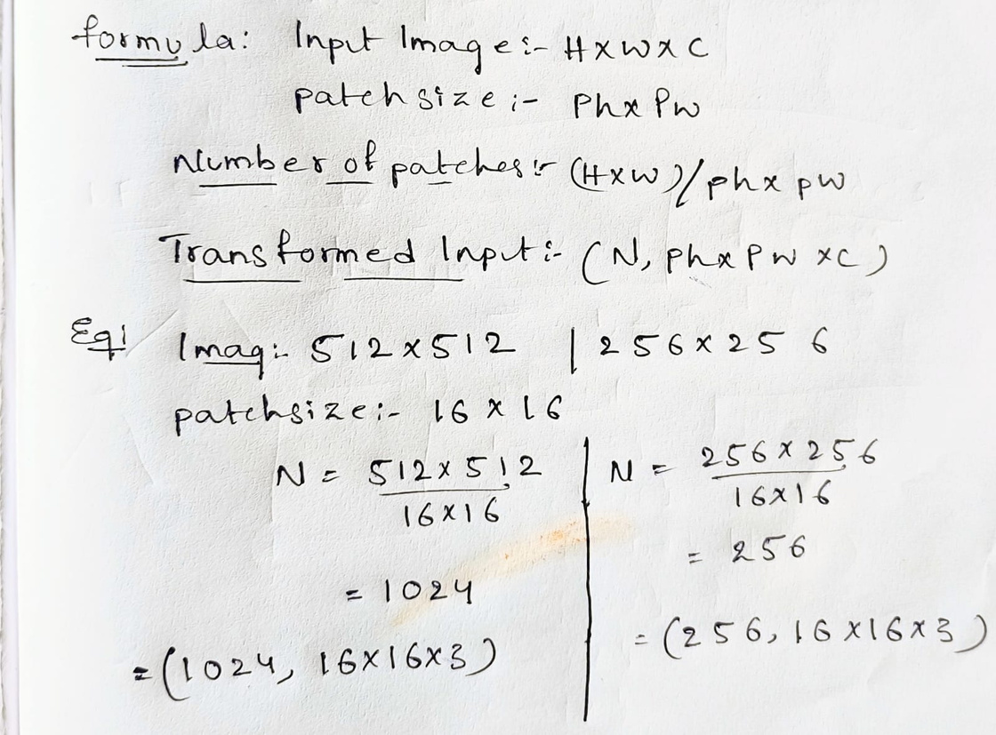
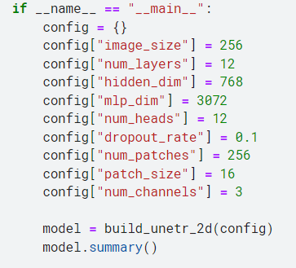
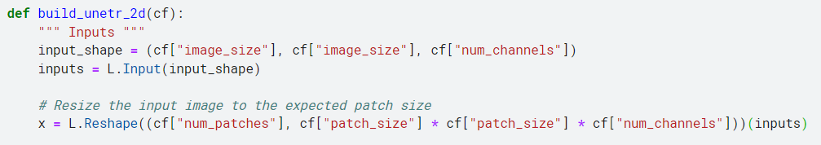
1. flattening the image into a tensor, where each row corresponds to a patch (or a segment) of the original image.
Theory:
Main :

Slide 5
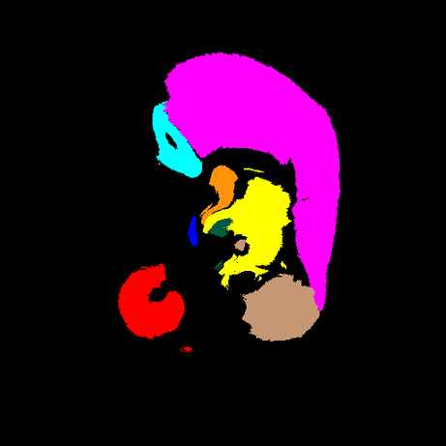
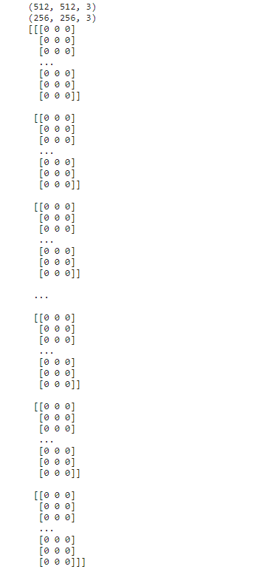
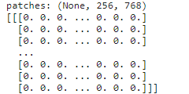

flattened images
and each row is a patch
256 X 256
512 X 512
input image

Slide 6
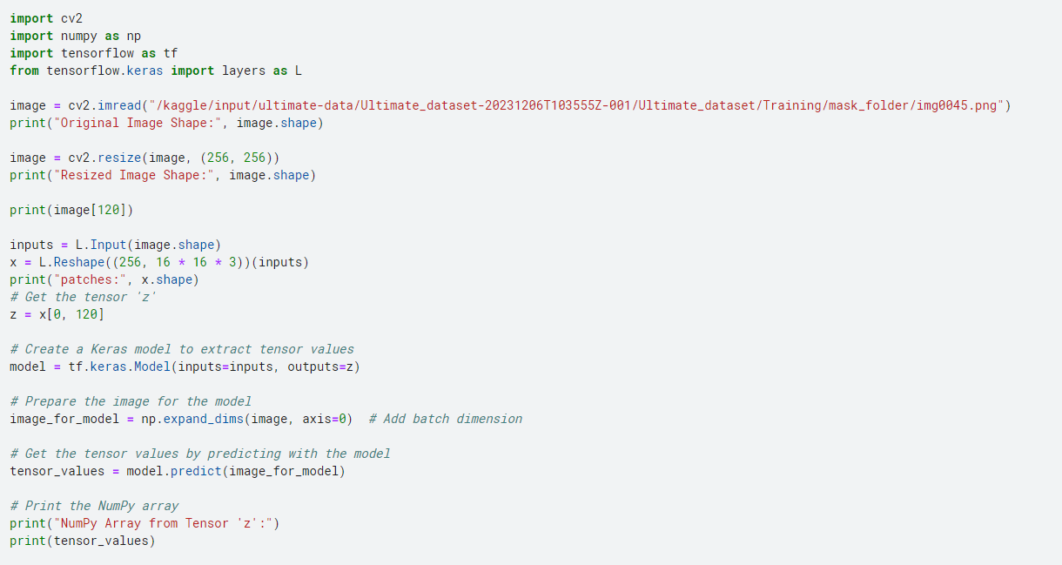
Respective Example code

Slide 7
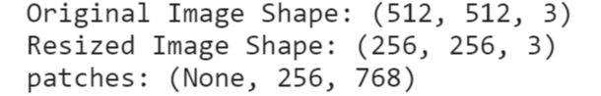
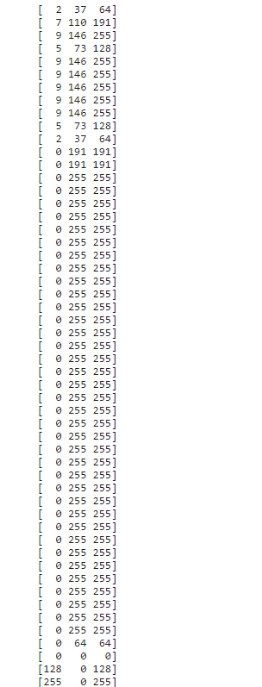
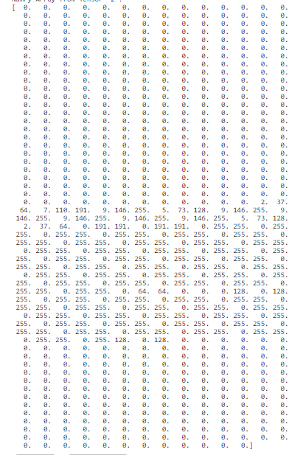
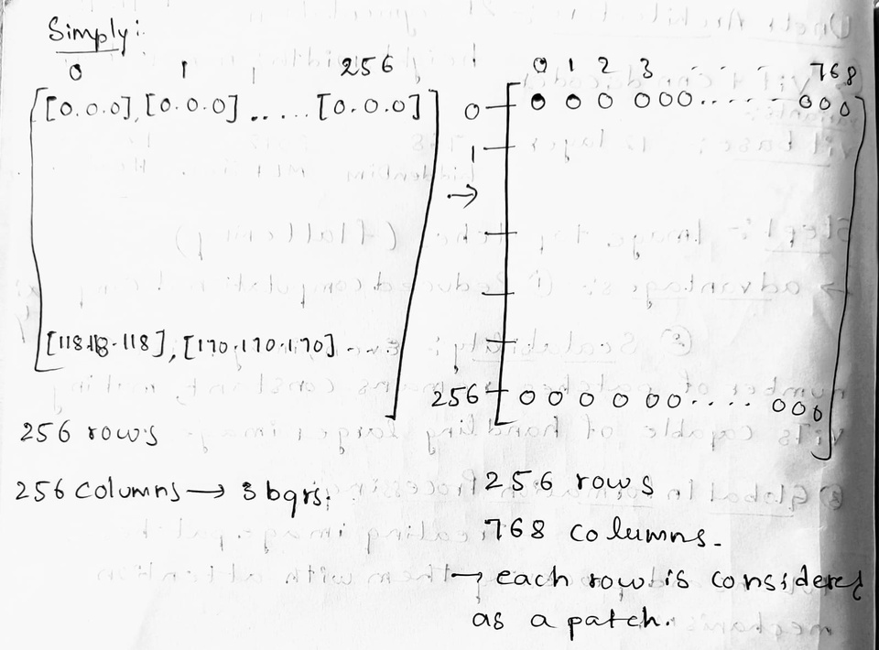
120th patch out of 256 patches
no.of patches

Slide 8
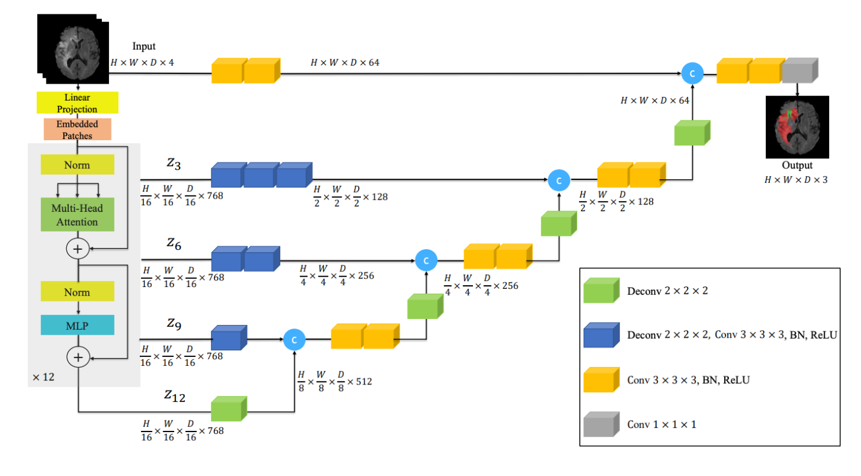
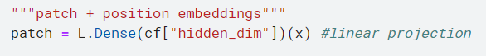
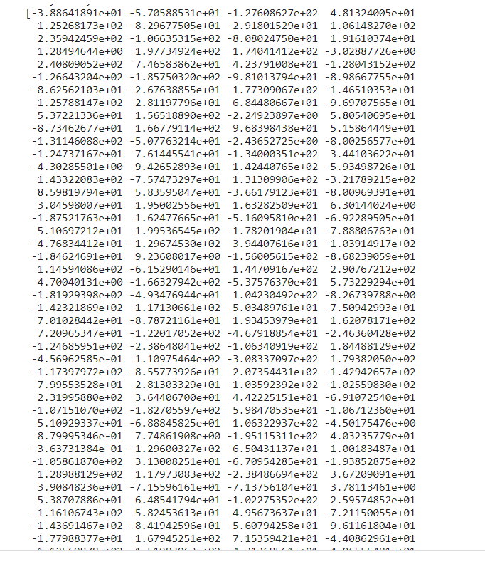
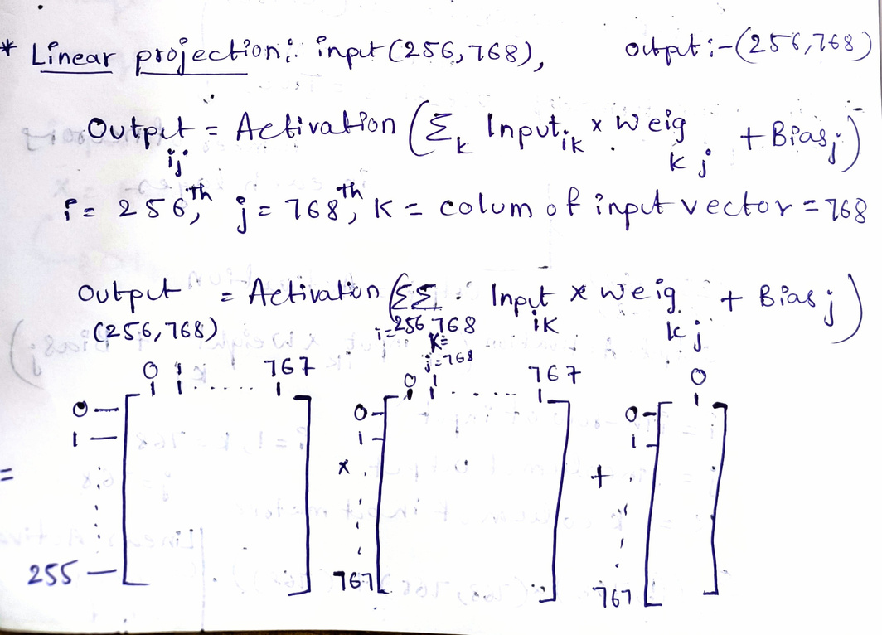
Linear projection:
i
The purpose of this linear projection is to map the pixel values of each patch into a higher-dimensional space, allowing the model to capture complex patterns and relationships in the image.

Slide 9
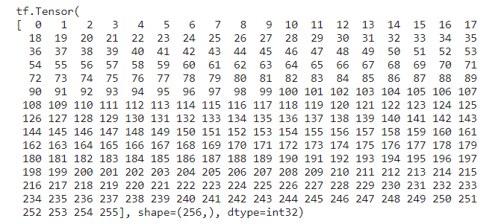
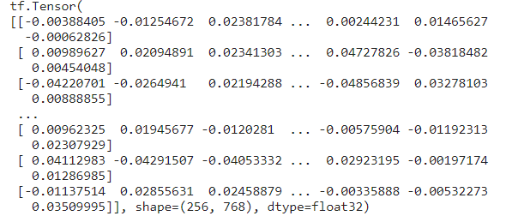
position
Embedding
The pre-built embedding_layer instance can then be added to a Sequential model
The Embedding layer can be understood as a lookup table that maps from integer indices to dense vectors (their embeddings)
This vector can be considered a feature vector that represents the position-specific information.

Slide 10
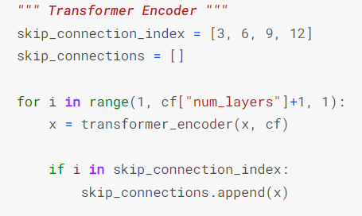
Encoder part :

Slide 11
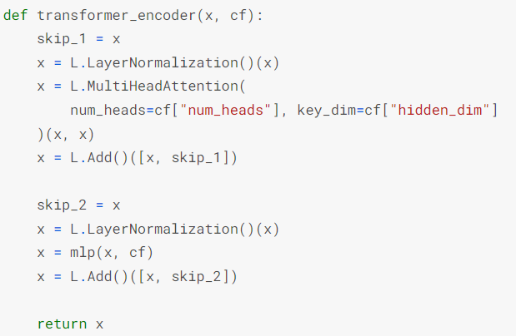
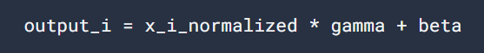
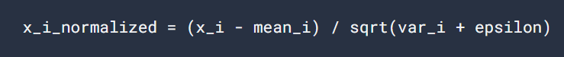
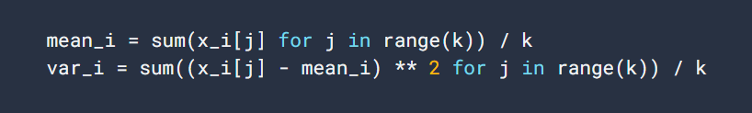
Normalization:

Slide 12
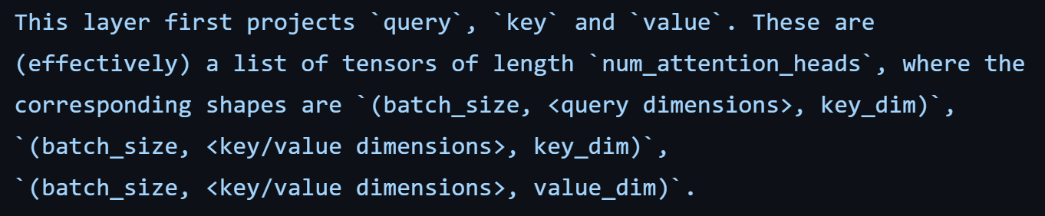
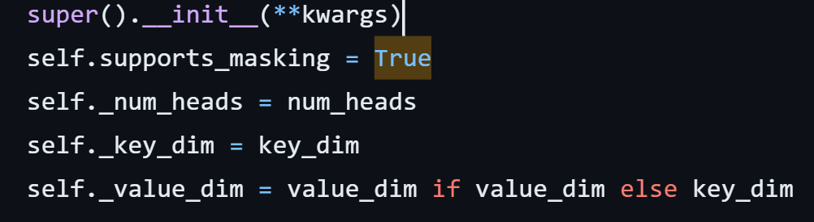
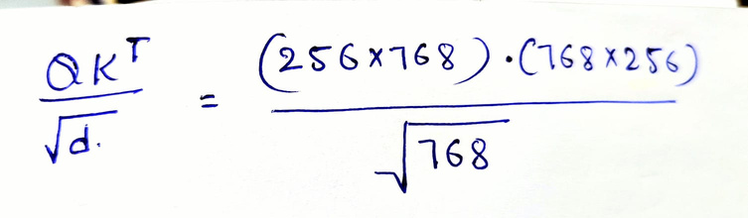
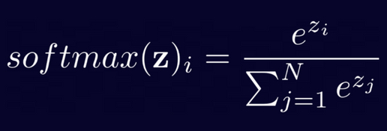
Multi-Head Attention:
256x768
256x768
256x64
256x256
256x256
256x256
256x64
256x64
256x64
input: 256,768
Query: 256,768
key: 256,768
value: 256,768
from this,
the linear matrix is 768,768
the query and key tensors are dot-producted and scaled
softmax applied to obtain attention probabilities

Slide 13
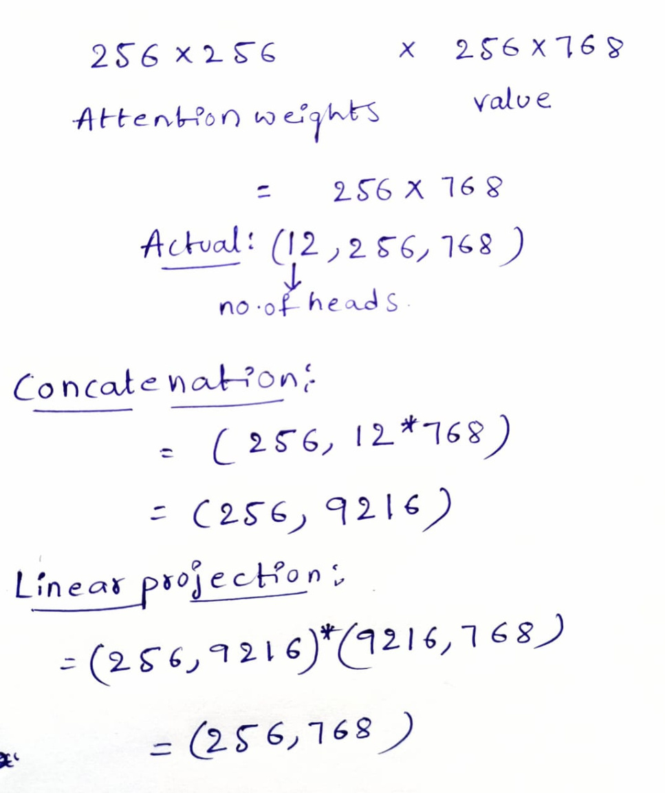
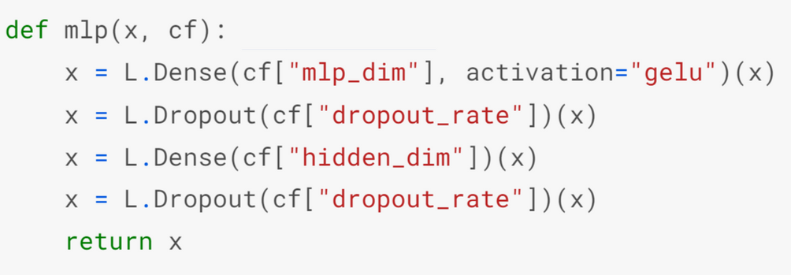
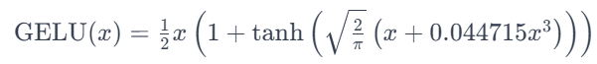
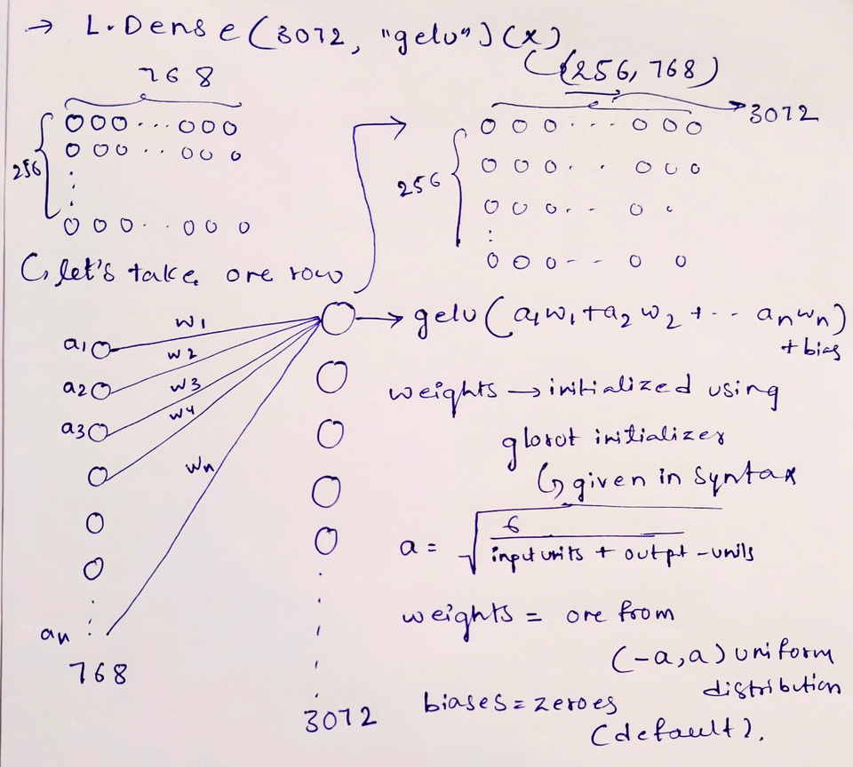
followed by norm and mlp
matmul

Slide 14
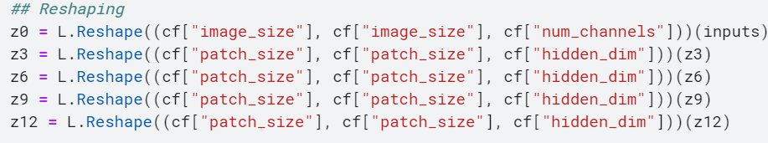
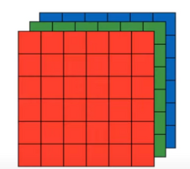
The output of the encoder block is 256 x 768
converted to 16 x 16 x 768 to enter decoder block
768
16
16
visualization

Slide 15
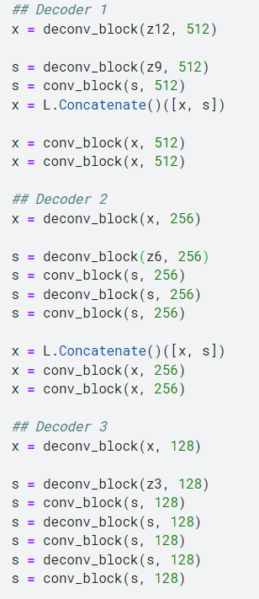
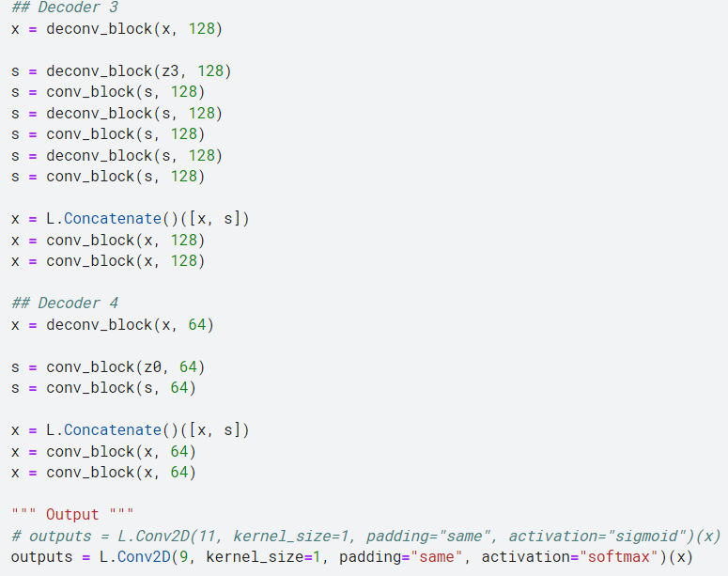
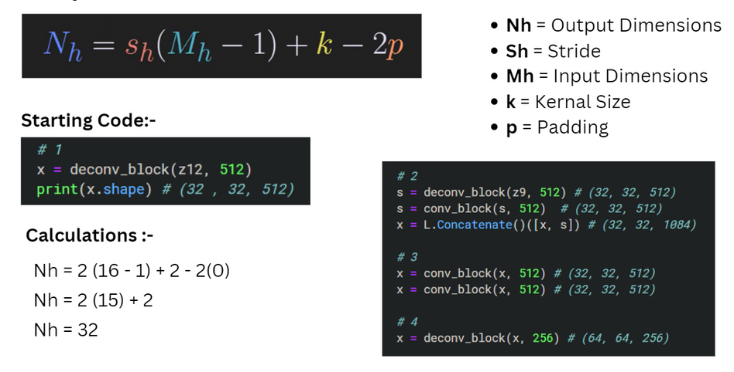
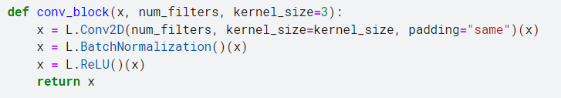
Deconv block
1(3-1)+3=5

Slide 16
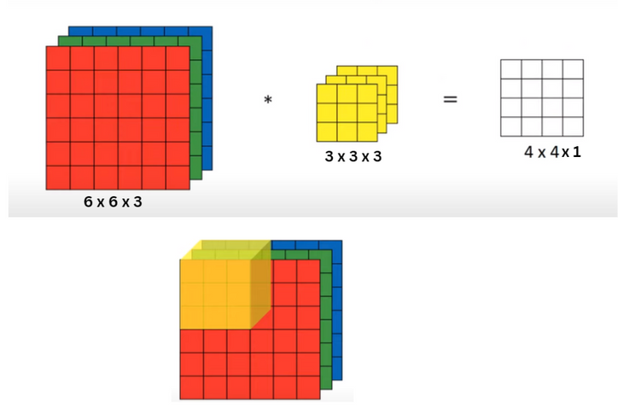
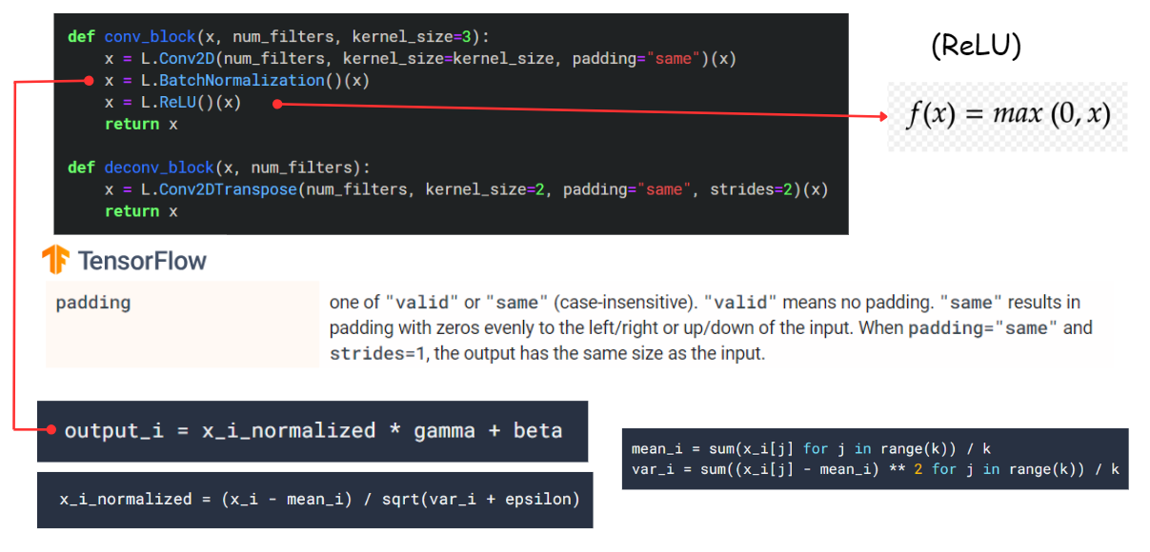
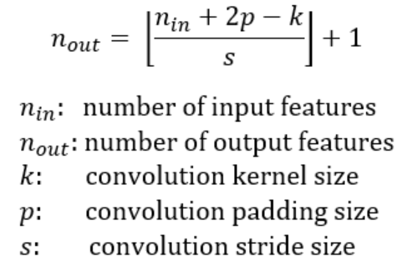
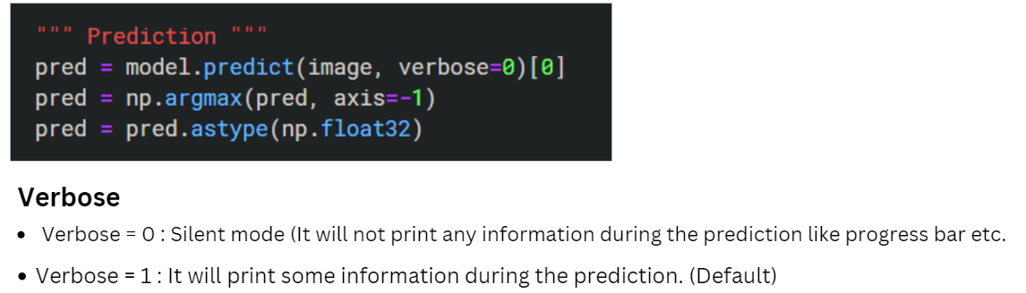
Conovulation block

Slide 17
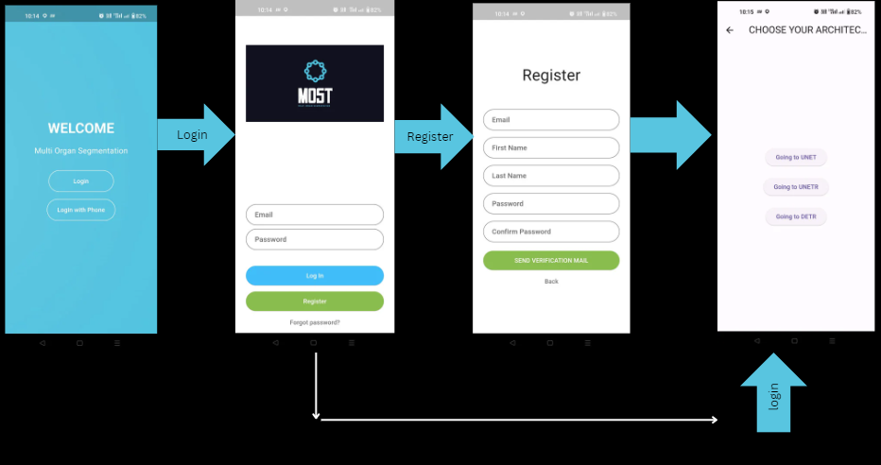
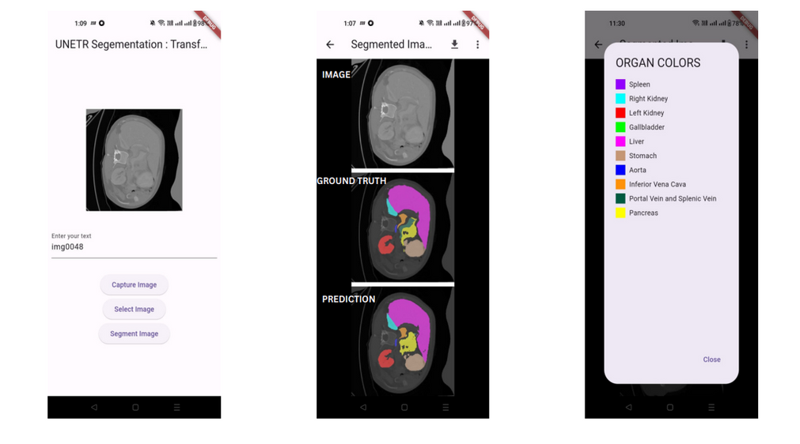

Flutter application

Slide 18


